Slide 1
Probability & Statistics
Rijah Khan
Cyber Security

Slide 2
Chapter 1:
Introduction to Statistics

Slide 3
Statistics
Statistics is the discipline that involves collecting, presenting, analyzing, and interpreting data. It encompasses methods for summarizing and drawing meaningful conclusions from data.
Collection
Presentation
Analysis
Interpretation

Slide 4
Types of statistics
Statistics can be broadly categorized into two main types:
Descriptive Statistics
Inferential Statistics

Slide 5
Descriptive Statistics
Descriptive statistics involve methods of summarizing and presenting data to gain insights into its main characteristics.
Some common descriptive statistics include:
Measures of Central Tendency
Measures of Dispersion or Variability
Measures of Shape and Distribution

Slide 6
Inferential Statistics
Inferential statistics involve using sample data to make inferences or draw conclusions about a larger population.
Some common inferential statistical techniques include:
Confidence Intervals
Hypothesis Testing
Analysis of Variance

Slide 7
Most commonly used terms in Statistics
Population
Sample
Parameter
Statistic
Constant
Variable

Slide 8
Population
Population refers to the entire group or set of individuals, items, or objects that are of interest in a particular study or analysis.
Total Number of observation in the data is known as Population size and it is denoted by N.

Slide 9
Sample
A sample refers to a subset of individuals, items, or data points that are selected from a larger population for the purpose of analysis.
Total Number of observation in the data is known as Sample size and it is denoted by n.

Slide 10
Parameter
A parameter is a numerical value or characteristic that summarizes a certain aspect of a population.
Parameters are fixed numbers.
Examples of Parameters:
Population Mean (μ): The average of all values in the population.
Population Variance (σ²): A measure of the spread of data in the population.

Slide 11
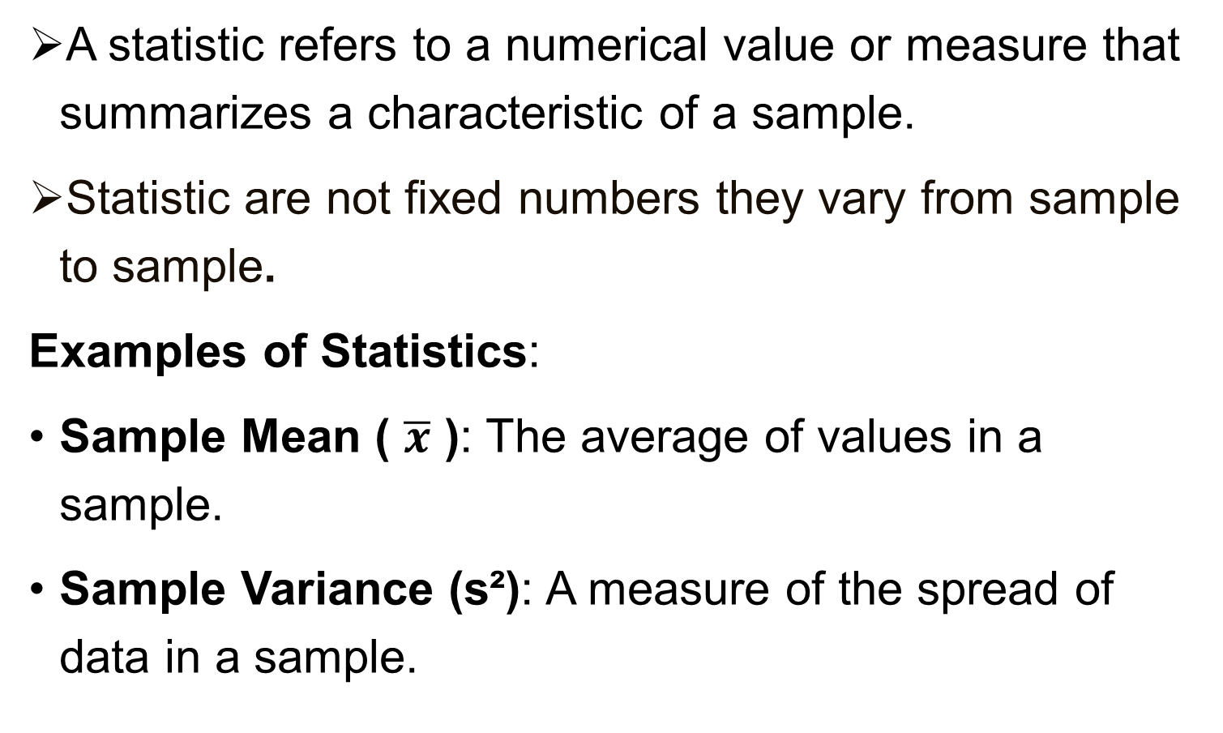
Statistic
A statistic refers to a numerical value or measure that summarizes a characteristic of a sample.
Statistic are not fixed numbers they vary from sample to sample.
Examples of Statistics:
Sample Mean ( $\overline{x}$ ): The average of values in a sample.
Sample Variance (s²): A measure of the spread of data in a sample.

Slide 12
Constant
A constant refers to a value that remains unchanged throughout a particular situation, formula, equation, or analysis.
For example:
e= 2.71828

Slide 13
Variable
A variable refers to a quantity or characteristic that can vary or change.
Variables are denoted by capital letters such as X, Y, Z while their respective values are denoted by small letters such as x, y, z.

Slide 14
Types of variables
There are two main types of variables:
Quantitative Variable
Qualitative variable

Slide 15
1: Quantitative Variable
A variable is called Quantitative variable when it deals with the characteristic which can be expressed numerically.
They are also called numerical variables.
Examples include height, weight, age etc.

Slide 16
2: Qualitative Variable
A variable is called qualitative variable when it deals with the characteristic which can not be expressed numerically.
They are also called Categorical variables.
Categorical variables represent categories or groups.
Examples include
gender (male/female)
color (red/blue/green)
education level (high school/college/graduate)

Slide 17
Types of Quantitative Variable
Numerical variables can be further categorized into 2 variables.
Discrete Variable
Continuous Variable

Slide 18
1: Discrete Variable
Discrete variables take on distinct, separate values.
They often involve counting.
Examples include:
The number of children in a family
The number of cars in a parking lot
The number of items sold

Slide 19
2: Continuous Variable
Continuous variables can take on an infinite number of values within a range.
They involve measurement and can be fractional or decimal.
Examples include
height
weight
temperature

Slide 20
Independent variables
Independent variables are manipulated or controlled in an experiment or analysis.
They are also called predictor variables or explanatory variables.
Examples include time, dosage of a drug, and temperature setting.

Slide 21
Dependent variables
Dependent variables are the outcomes, results, or responses being measured in an experiment or analysis.
They are affected by changes in the independent variable.
Examples include test scores, sales revenue, and blood pressure readings.

Slide 22
Data
Data refers to factual information or raw facts that are collected, observed, or measured in various contexts. Data can take various forms and can be structured or unstructured.

Slide 23
Types of Data
Qualitative Data: This type of data describes qualities or characteristics and is often categorical.
Examples include colors, genders, and types of fruits.
Quantitative Data: This type of data consists of numerical values that can be measured. It can be further categorized into discrete and continuous data.
Examples include height, weight, age etc.

Slide 24
Classification of data according to source
Primary Data
Secondary Data

Slide 25
Primary data
Data that have been originally collected is known as primary data.
It is collected firsthand by researchers directly from the source.

Slide 26
Secondary Data
Secondary data refers to data that has been collected and recorded by someone else for a purpose other than the current research study or analysis.
It is data that already exists and is available for researchers.

Slide 27
Methods of primary data collection
Direct Personal Investigation
Indirect Oral Investigation
Registration
Collection through questionnaire
Collection through enumerators
Collection through local source

Slide 28
Methods of Secondary data collection
Officials
Semi officials
Journals and newspapers
Research organizations

Slide 29
Scales of Measurement
The scale determines the amount of information contained in the data. There are four scales of measurement.
Nominal
Ordinal
Interval
Ratio

Slide 30
Nominal
This is the simplest level of measurement, where data is categorized into distinct groups or categories with no inherent order.
Example:
Categorizing people's eye color as "blue," "brown," "green," etc., is a nominal measurement.

Slide 31
Ordinal
In this scale, data is categorized into distinct groups like in a nominal scale, but there's also an implicit order or ranking among the categories.
Example:
Students of a FAST University are classified by their class standing using a nonnumeric label such as Freshman, Junior, or Senior.

Slide 32
INTERVAL
Interval scale has both an order between values and a consistent interval between them, but it lacks a true zero point.
Example:
Temperatures on the Celsius or Fahrenheit scales, where a difference of 10 degrees has the same meaning throughout the scale, but a temperature of 0°C does not mean "no temperature."

Slide 33
RATIO
Ratio scale must contain a zero value that indicates that nothing exists for the variable at the zero point.
Example:
Distances measured in kilometers, miles, or any unit of length are on a ratio scale. They have a true zero point (zero distance means no distance traveled).

